Slide 1
W3_D4 - Time series
Sivasankar Arul

Slide 2
Stationarity
Mean, variance and autocorrelation doesnot change.
Augmented Dickey-Fuller (ADF) test and the Kwiatkowski-Phillips-Schmidt-Shin (KPSS) test.
Can be made stationary - by differencing
Parameter:
Multiplicative seasonality is not appropriate for zero and negative values

Slide 3
Choosing between additive and multiplicative
1. Additive Model
The additive model assumes the components combine linearly:
When to Use:
The magnitude of the seasonal variations is constant over time.
Example: Temperature data where seasonal fluctuations (highs and lows) remain roughly the same year after year.
2. Multiplicative Model
The additive model assumes the components combine proportionally
When to Use:
The magnitude of seasonal variations changes proportionally with the level of the trend.
Example: Sales data where seasonal spikes grow as the overall trend increases (e.g., higher sales in December proportional to yearly growth).
Check for Proportionality:
If the seasonal variations grow/shrink with the trend, use a multiplicative model.
If the seasonal variations are independent of the trend, use an additive model.

Slide 4
ADF test
Statistical test for presence of unit root.
P.S. If series has unit root property, it is not stationary
Null: series has unit root, it is non stationary
Alternate: not have unit root, meaning it is stationary
If P < 0.05: the probability of getting a sample as extreme as the current one is less. Therefore null hypothesis is rejected. Alternate hypothesis is true:
The series does not have unit root, therefore it is stationary.

Slide 5
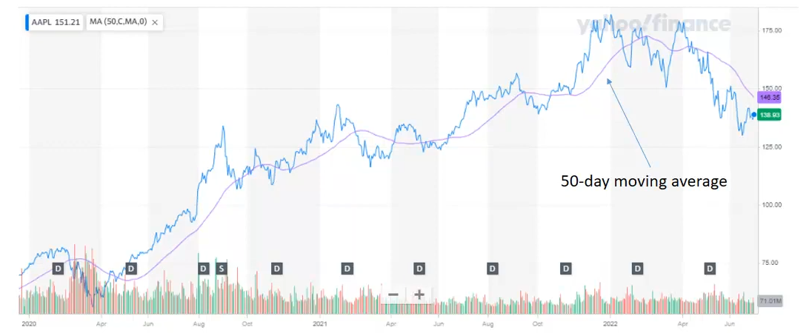
Moving average

Slide 6
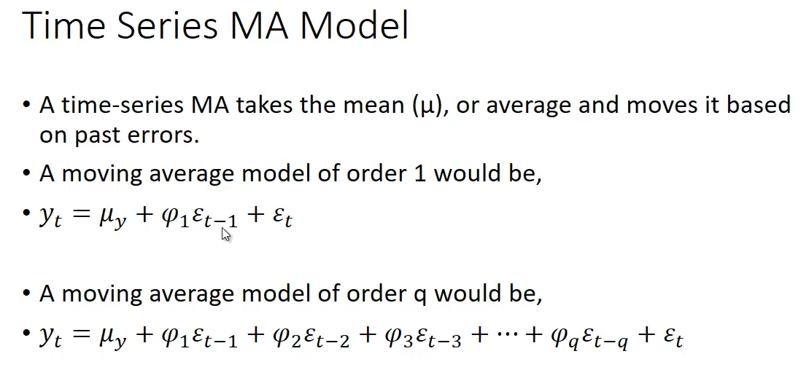

Slide 7
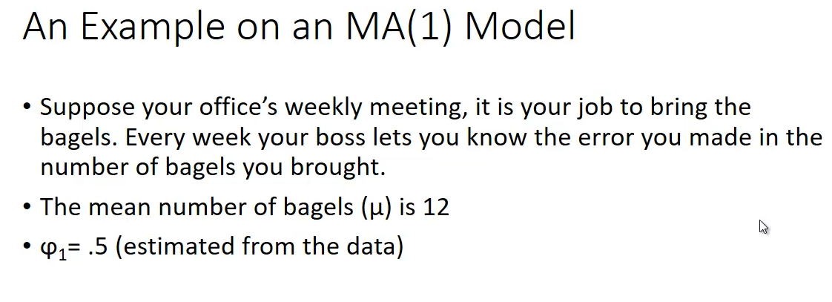

Slide 8
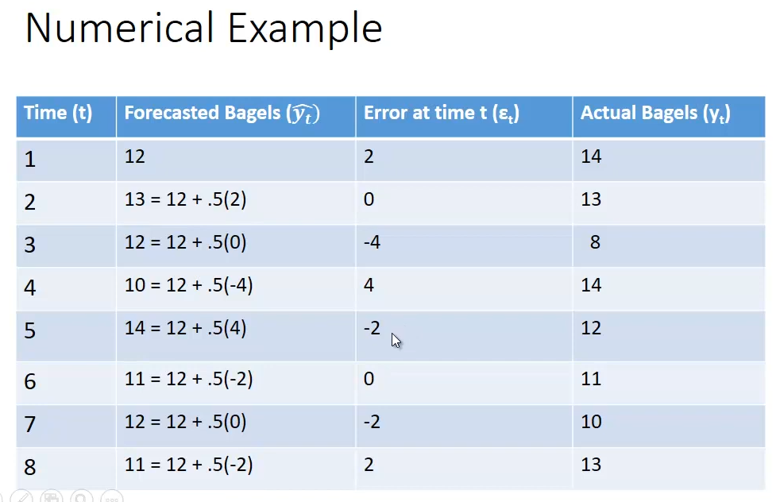
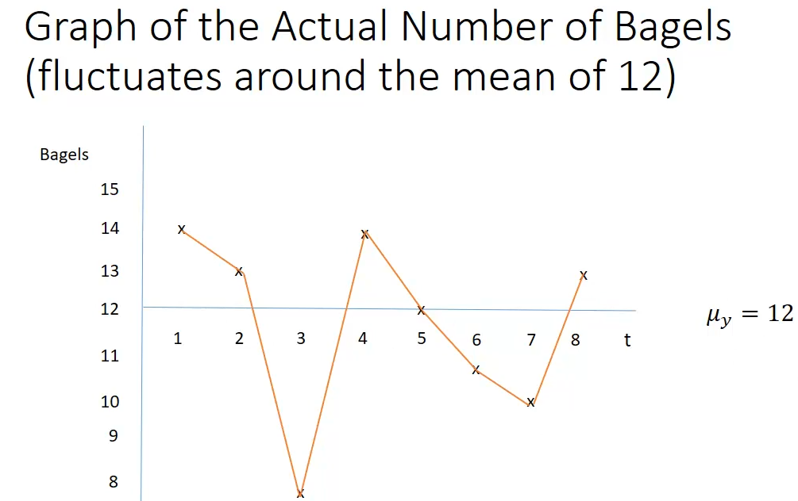

Slide 9
ACF and PACF
Food festival every 2 months
S(t-2)
S(t-1)
S(t)
Pearson correlation
ACF
Two effect
Direct route (t-2) -> t
Indirect route (t-2) through (t-1) to t
Considers both effect
auto correlation
(t-2) (t)
Jan | Mar
Feb | Apr
Mar | May

Slide 10
ACF and PACF
Food festival every 2 months
S(t-2)
S(t-1)
S(t)
PACF
Only direct effect
Direct route (t-2) -> t
Partial auto correlation
(t-2) (t)
s(t) = a*s(t-1) + b*(t-2) + e
After fitting this, b tell me direct effect of t-2 to t
Because a took effect of t-1 on t
Determines AR terms

Slide 11
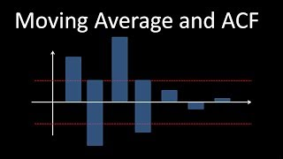
ACF to determine if MA is good model for data

Slide 12
A sharp cutoff in ACF suggests an MA model.
A sharp cutoff in PACF suggests an AR model.
Slowly decaying ACF suggests a trend.
Seasonality appears as periodic spikes in both ACF and PACF at seasonal lags.

Slide 13
SARIMA
Why This Model?
This SARIMA model captures both the trend (non-seasonal ARIMA components) and seasonality (seasonal ARIMA components).
It’s tailored for datasets like AirPassengers that have both a strong seasonal pattern and a clear trend over time.

Slide 14
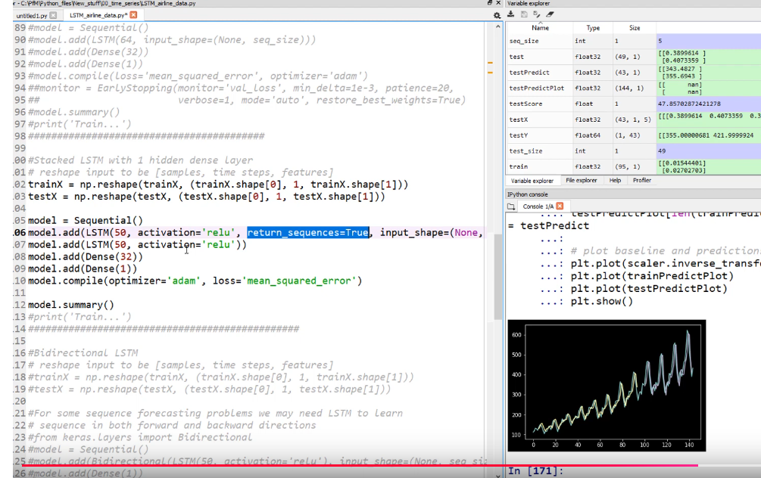
LSTM

Slide 15
